Slide 1
Cainan Black Senior Project
Java Calculator Application

Slide 2
Eclipse and Swing
All work has been using Eclipse and Swing to create the class for the calculator and the User Interface.
General work on the layout is complete, next faze is refinement and addition of features (aka the bulk of the project)

Slide 3
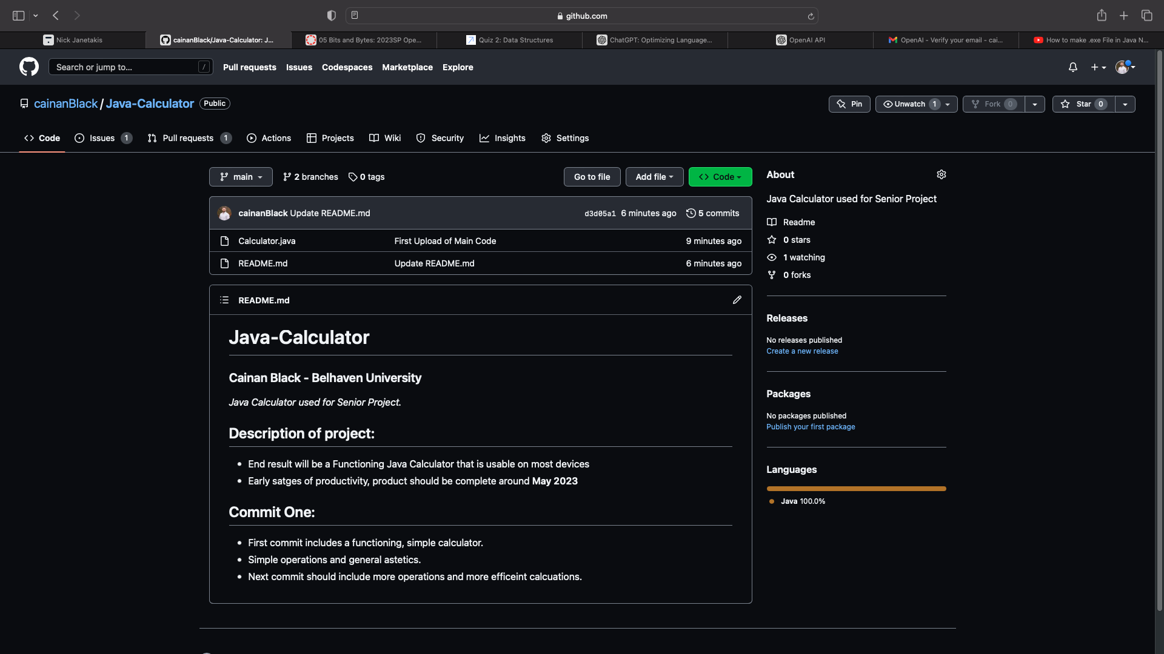
Git Repo
Added all the code and slides to the gitHub repo.
So far there is only one commit with my code, in the main branch.
There is a separate branch to hold weekly slides.

Slide 4
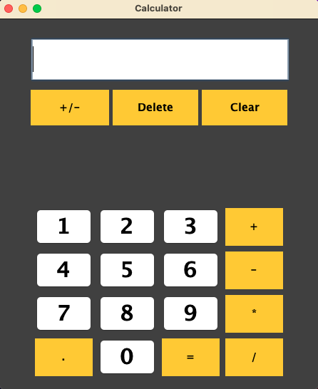
How it looks, for right now:
Tried to make the color scheme line up with the apple scheme, will make changes in the future for a unique aspect.
Pretty bare and generic right now.

Slide 5
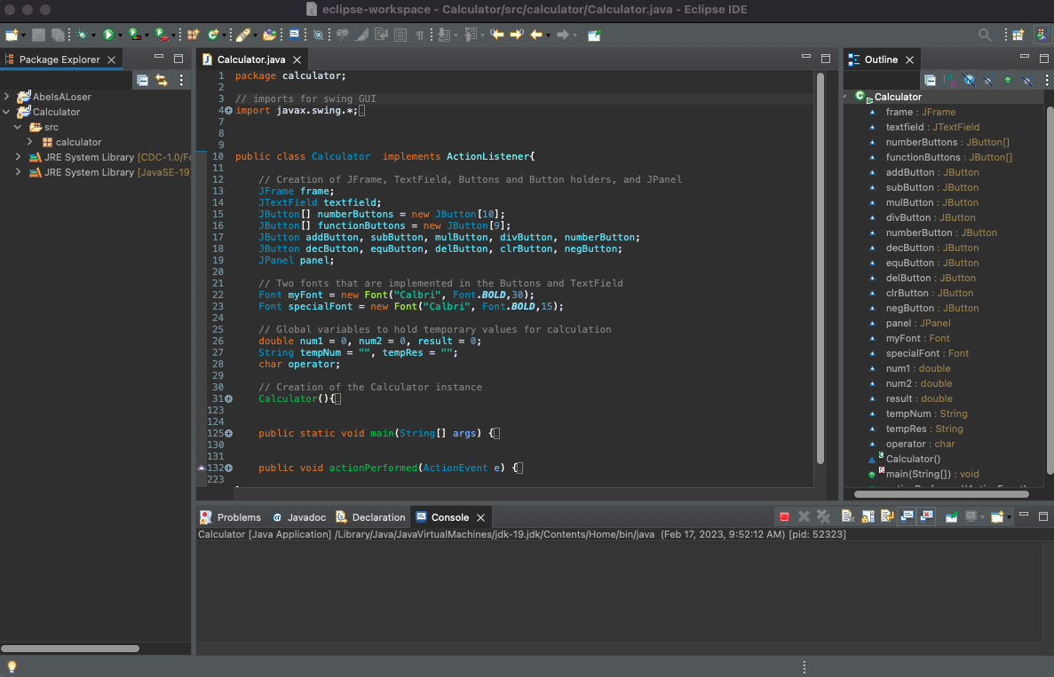
Main Code:
Very small and hard to read, sorry! (Code is in the repo if you want to look at it closer)
Main class that holds all the formatting information
Supporting functions for math and operation.

Slide 6
Work for next week
More functions
Improve layout of buttons (new JPanel?)
Try to improve on how the calculations are done to create opportunity for more complex math.

